Slide 1

CHAPTER THREE
XML, Intents and Services
By: Behayilu M.
Faculty of Computing and Software Engineering(FCSE),
Arba Minch Institute of Technology(AMiT),
Arba Minch University

Slide 2
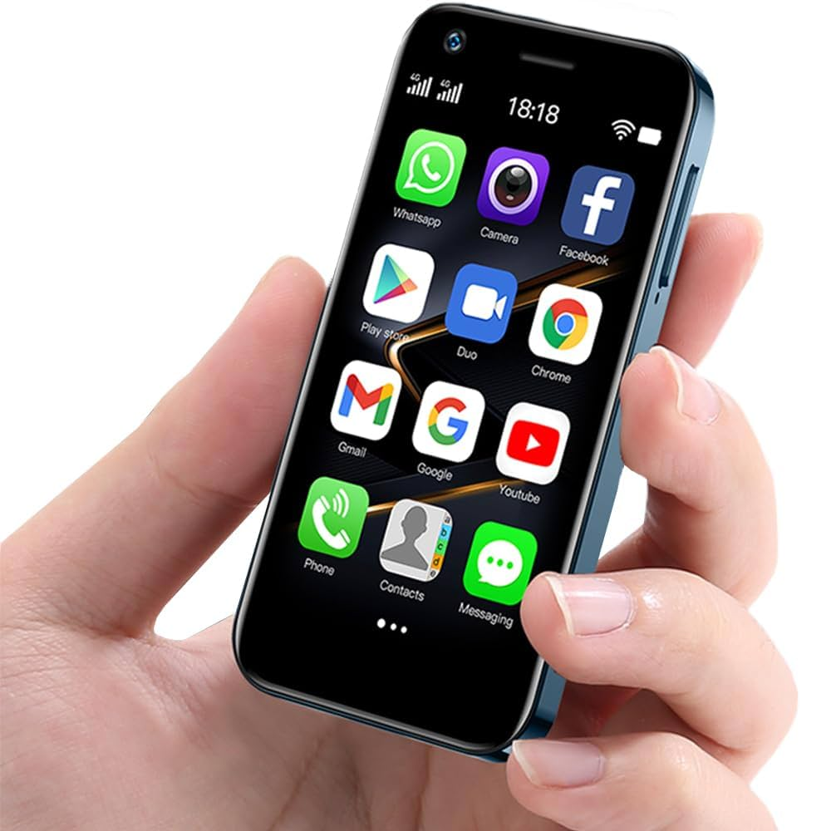
CONTENTS
What is XML in android
Describe Intents
Describe Activities
Describe Services
Explain characteristics of mobile applications
Successful mobile application development

Slide 3
What is XML in Android?
XML (Extensible Markup Language) is used in Android to define user interface (UI) layouts — meaning, how your app looks (its screens and components).
Every layout file in Android ends with .xml and is stored in:
app → res → layout → activity_main.xml
Basic Structure of XML
<?xml version="1.0" encoding="utf-8"?>
<LinearLayout
xmlns:android="http://schemas.android.com/apk/res/android"
android:layout_width="match_parent"
android:layout_height="match_parent"
android:orientation="vertical">
<TextView
android:id="@+id/textView"
android:layout_width="wrap_content"
android:layout_height="wrap_content"
android:text="Hello XML!" />
</LinearLayout>

Slide 4
Explanation
<?xml ... ?> → XML declaration.
Root element: Only one (e.g., LinearLayout,RelativeLayout or ConstraintLayout etc).
xmlns:android → Defines Android XML namespace.
To tell the system that these attributes belong to the Android framework (not custom ones)
Attributes:
  android:layout_width → width of the view (match_parent, wrap_content, or fixed value like 200dp)
  android:layout_height → height of the view
  android:id → unique ID to access the view from Java code
  android:text → sets the displayed text for TextView, Button, etc.

Slide 5
Common Layout Types (Containers)
Layouts are containers that define how child views (buttons, text, etc.) are arranged.
a) LinearLayout
Arranges elements in a single row or column.
<LinearLayout
xmlns:android="http://schemas.android.com/apk/res/android"
android:layout_width="match_parent"
android:layout_height="match_parent"
android:orientation="vertical"
android:padding="16dp">
<TextView
android:text="Hello Behayilu!"
android:layout_width="wrap_content"
android:layout_height="wrap_content" />
<Button
android:text="Click Me"
android:layout_width="wrap_content"
android:layout_height="wrap_content" />
</LinearLayout>
Hello Behayilu
Click Me

Slide 6
b) RelativeLayout
Positions elements relative to each other or the parent container.
<RelativeLayout
xmlns:android="http://schemas.android.com/apk/res/android"
android:layout_width="match_parent"
android:layout_height="match_parent">
<TextView
android:id="@+id/titleText"
android:text="Welcome"
android:layout_width="wrap_content"
android:layout_height="wrap_content" />
<Button
android:text="Start"
android:layout_width="wrap_content"
android:layout_height="wrap_content"
android:layout_below="@id/titleText"
android:layout_centerHorizontal="true" />
</RelativeLayout>
Welcome
Start

Slide 7
c) ConstraintLayout (Most Modern)
Modern, flexible layout.
Allows you to position views using constraints — alignments between views and the parent.
<androidx.constraintlayout.widget.ConstraintLayout
android:layout_width="match_parent"
android:layout_height="match_parent">
<TextView
android:id="@+id/helloText"
android:layout_width="wrap_content"
android:layout_height="wrap_content"
android:text="Hello ConstraintLayout!"
app:layout_constraintTop_toTopOf="parent"
app:layout_constraintStart_toStartOf="parent"
app:layout_constraintEnd_toEndOf="parent"/>
</androidx.constraintlayout.widget.ConstraintLayout>

Slide 8
d) TableLayout
Organizes views into rows and columns using TableRow.
<TableLayout
android:layout_width="match_parent"
android:layout_height="wrap_content">
<TableRow>
<TextView android:text="Name:" />
<EditText android:hint="Enter name" />
</TableRow>
<TableRow>
<TextView android:text="Age:" />
<EditText android:hint="Enter age" />
</TableRow>
</TableLayout>
Name:
Enter name
Age:
Enter age

Slide 9
XML unit measurements
1. Density-independent Pixels (dp or dip)
Used for: View dimensions — width, height, margins, paddings, etc.
Meaning: A unit that adjusts automatically based on screen density (so UI looks the same on all devices).
Example:
✅ Best for: General layout measurements.
<Button
android:layout_width="200dp"
android:layout_height="60dp"
android:layout_margin="8dp"/>

Slide 10
XML unit measurements
2. Scale-independent Pixels (sp)
Used for: Text sizes only. Meaning: Similar to dp, but also scales according to the user's font size preference (Accessibility).
Example
✅ Best for: Font sizes.
3. Pixels (px)
Used for: Very precise control (rarely recommended).
Meaning: Actual physical pixels on the screen — doesn’t adjust for screen density.
<TextView
android:layout_width="wrap_content"
android:layout_height="wrap_content"
android:textSize="18sp"/>

Slide 11
Common Attributes in Layouts
Attribute | Description | Example
android:id | Unique ID for view | @+id/btnSubmit
android:layout_width | Width of view | match_parent
android:layout_height | Height of view | wrap_content
android:padding | Space inside the view | 8dp
android:margin | Space outside the view | 10dp
android:gravity | Aligns content inside view | center
android:orientation | Direction (LinearLayout) | vertical
android:text | Text content | "Hello"

Slide 12
Connecting XML to Java
XML files define the User Interface (UI) — what the app looks like.
Java files define the logic — what the app does.
Step 1: Create XML Layout
Step 2: Open the Corresponding Java File
Step 3: Set the Layout Using setContentView(R.layout.activity_main);
Step 4: Get References to Views Using findViewById()
<Button
android:id="@+id/buttonChangeText"
android:layout_width="wrap_content"
android:layout_height="wrap_content"
android:text="Change Text" />
TextView textView = findViewById(R.id.textViewMessage);
Button button = findViewById(R.id.buttonChangeText);

Slide 13
Common UI Elements (Widgets)
TextView: To add some text in your application.
EditText: This is used when you want to take some input from the users.
ImageView: To add some image in the application.
ProgressBar: To show the progress to something. For example, the loading screen.
Button: Buttons are used to trigger some action on the click of the button. It can be starting a new activity or something else.
ImageButton: It is used to make a clickable image.
CheckBox: CheckBox is used to select some options out of many available options.
DatePicker: To select some particular date.
SeekBar for sliding left or right to a setting
RadioGroup of RadioButton elements for selecting one option
RatingBar can be used to get the rating from the user.
Switch for turning on or turning off an option
Spinner drop-down menu for selecting one option

Slide 14
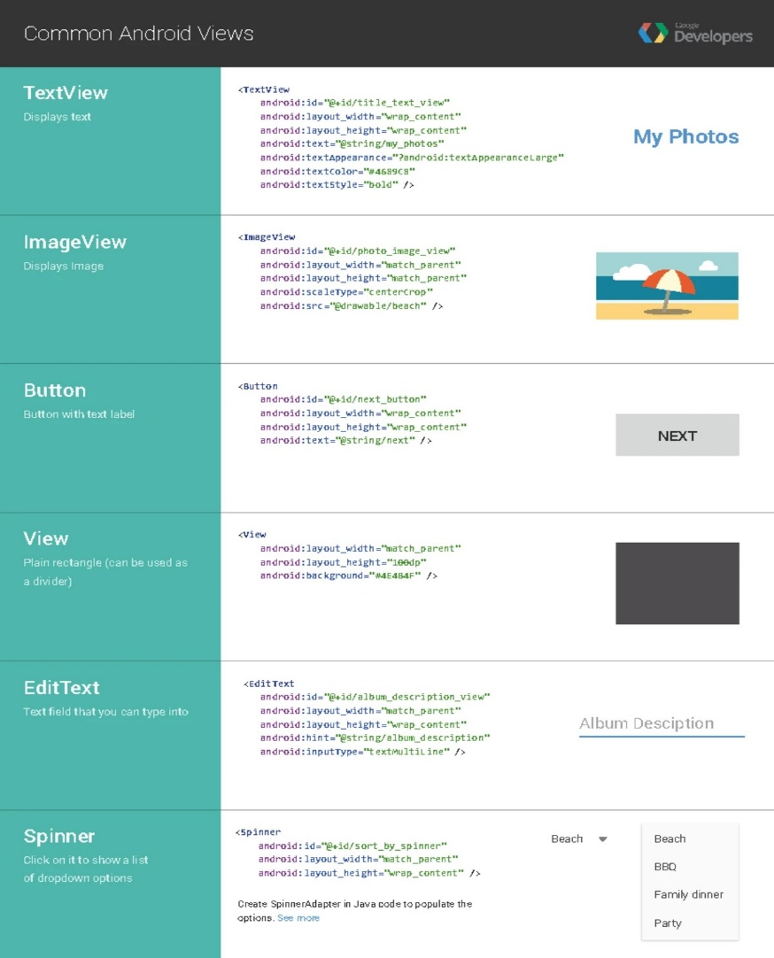
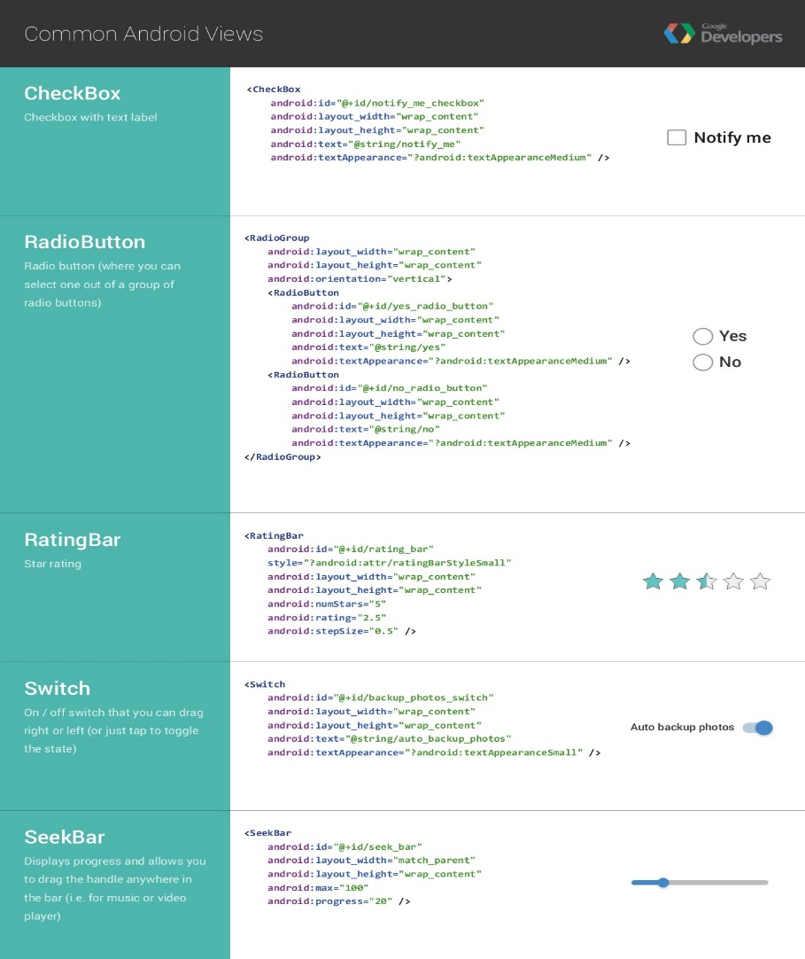
Common Views

Slide 15
What is Activity?
In Android, an activity is referred to as one screen in an application.
It is very similar to a single window of any desktop application.
An Android app consists of one or more screens or activities.
Each activity goes through various stages or a lifecycle and is managed by activity stacks.
So when a new activity starts, the previous one always remains below it.
There are four stages of an activity.
If an activity is in the foreground of the screen i.e at the top of the stack, then it is said to be active or running. This is usually the activity that the user is currently interacting with.

Slide 16
What is Activity?
2) If an activity has lost focus and a non-full-sized or transparent activity has focused on top of your activity. In such a case either another activity has a higher position in multi-window mode or the activity itself is not focusable in the current window mode. Such activity is completely alive.
3) If an activity is completely hidden by another activity, it is stopped or hidden. It still retains all the information, and as its window is hidden thus it will often be killed by the system when memory is needed elsewhere.
4) The system can destroy the activity from memory by either asking it to finish or simply killing its process. When it is displayed again to the user, it must be completely restarted and restored to its previous state.

Slide 17
Activity Example
Every activity is a subclass of AppCompatActivity and consists of two main parts:
package com.example.myapp;
import androidx.appcompat.app.AppCompatActivity;
import android.os.Bundle;
import android.widget.Button;
import android.widget.Toast;
public class MainActivity extends AppCompatActivity {
@Override
protected void onCreate(Bundle savedInstanceState) {
super.onCreate(savedInstanceState);
setContentView(R.layout.activity_main);
Button btn = findViewById(R.id.btnNext);
btn.setOnClickListener(v ->
Toast.makeText(this, "Button Clicked!", Toast.LENGTH_SHORT).show()
);
}}}
<LinearLayout xmlns:android="http://schemas.android.com/apk/res/android"
android:layout_width="match_parent"
android:layout_height="match_parent"
android:orientation="vertical"
android:gravity="center">
<TextView
  android:id="@+id/textView"
  android:text="Welcome to My App!"
  android:textSize="24sp"
  android:layout_marginBottom="20dp" />
<Button
  android:id="@+id/btnNext"
  android:text="Next"
  android:layout_width="wrap_content"
  android:layout_height="wrap_content" />
</LinearLayout>

Slide 18
Activity Lifecycle in Android
The Activity Lifecycle defines the states an activity goes through from creation to destruction.
When you open, minimize, rotate, or close it — Android calls specific lifecycle methods to manage what happens.
These methods help you control:
  What happens when the activity starts
  What happens when it’s visible
  What happens when it’s paused or destroyed

Slide 19
Activity Lifecycle in Android
Method | When it’s called | Purpose
onCreate() | When the activity is first created | Initialize UI components, set layout, load data
onStart() | When the activity becomes visible to the user | Prepare UI (but not yet ready for interaction)
onResume() | When the activity starts interacting with the user | Start animations, sensors, or music
onPause() | When another activity comes partially in front | Pause ongoing tasks (like video, animations)
onStop() | When the activity is no longer visible | Release resources, save data
onRestart() | When the activity is about to restart after being stopped | Reinitialize components
onDestroy() | Before the activity is destroyed | Cleanup memory, close database connections

Slide 20
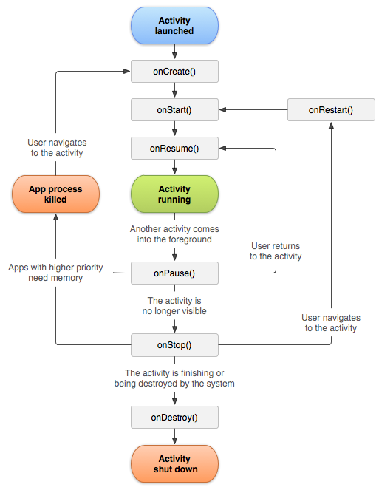
Activity Lifecycle in Android

Slide 21
package com.example.lifecycleapp;
import androidx.appcompat.app.AppCompatActivity;
import android.os.Bundle;import android.util.Log;
public class MainActivity extends AppCompatActivity
{
private static final String TAG = "ActivityLifecycle";
protected void onCreate(Bundle savedInstanceState) {
super.onCreate(savedInstanceState);
setContentView(R.layout.activity_main);
Log.d(TAG, "onCreate called");
}
protected void onStart() {
super.onStart();
Log.d(TAG, "onStart called");
}
protected void onResume() {
super.onResume();
Log.d(TAG, "onResume called");}
protected void onPause() {
super.onPause();
Log.d(TAG, "onPause called");}
protected void onStop() {
super.onStop();
Log.d(TAG, "onStop called");}
protected void onRestart() {
super.onRestart();
Log.d(TAG, "onRestart called");}
protected void onDestroy() {
super.onDestroy();
Log.d(TAG, "onDestroy called");
}}

Slide 22
What is Logcat in Android Studio?
Logcat (short for Log + Concatenate) is a built-in tool in Android Studio used to display system messages, app logs, and debugging information in real time while your app is running.
It’s like a console window that shows everything happening inside your app — useful for finding errors, crashes, and tracking activity lifecycle events.
Purpose | Example
Debugging code | Check what happens when a button is clicked or a function runs.
Error tracking | Find crash messages or exceptions (NullPointerException, etc.).
Lifecycle tracing | Observe onCreate(), onStart(), onPause(), etc.
System messages | View Android OS messages or system logs.

Slide 23
Log Levels
Level | Description | Method
Verbose | Shows all logs (lowest priority). | Log.v()
Debug | For debugging information. | Log.d()
Info | General information messages. | Log.i()
Warn | Warnings that might cause problems. | Log.w()
Error | Serious issues or crashes. | Log.e()

Slide 24
What is a Toast in Android Studio?
A Toast is a small popup message that briefly appears at the bottom of the screen to show feedback to the user.
It automatically disappears after a short time (no user action needed).
👉 Think of it as a temporary notification
for example:
“Message sent successfully”
“Data saved”
“Login failed”
Feature | Description
Visibility | Appears temporarily, then disappears automatically
Position | By default at the bottom of the screen, but can be moved
Duration | Can be short or long (LENGTH_SHORT or LENGTH_LONG)
Lightweight | Does not block user interaction (non-intrusive)
Common Use | For brief status or confirmation messages

Slide 25
What is a Toast in Android Studio?
Basic Syntax
Toast.makeText(context, text, duration).show();
Parameters:
context → usually this (or MainActivity.this)
text → the message to display
duration → how long the toast stays visible
Toast.LENGTH_SHORT (~2 seconds)
Toast.LENGTH_LONG (~3.5 seconds)
Toast.makeText(this, "Welcome, Behayilu!", Toast.LENGTH_SHORT).show();
btn.setOnClickListener(v -> {
Toast.makeText(MainActivity.this, "Button Clicked!", Toast.LENGTH_LONG).show();
});

Slide 26
What is an Event in Android ?
An event is any user interaction with your app’s UI — for example:
  Clicking a button
  Typing in an EditText
  Selecting an item from a Spinner
  Touching or swiping on the screen
Common Event Listeners
Android provides listeners — interfaces that you can attach to UI elements to handle events.

Slide 27
Common Event Listeners
Event Type | Listener Interface | Common Method
Button click | View.OnClickListener | onClick(View v)
Long click | View.OnLongClickListener | onLongClick(View v)
Touch | View.OnTouchListener | onTouch(View v, MotionEvent e)
Focus change | View.OnFocusChangeListener | onFocusChange(View v, boolean hasFocus)
Key press | View.OnKeyListener | onKey(View v, int keyCode, KeyEvent event)
Text change | TextWatcher | afterTextChanged(), beforeTextChanged(), onTextChanged()

Slide 28
Method 1: Using setOnClickListener()
Most common method for buttons and other clickable views.
Button myButton = findViewById(R.id.myButton);
myButton.setOnClickListener(new View.OnClickListener() {
@Override
public void onClick(View v) {
Toast.makeText(MainActivity.this, "Button Clicked!", Toast.LENGTH_SHORT).show();
}
});

Slide 29
Method 2: Implement Listener Interface in Activity
This method makes your activity itself handle the event.
public class MainActivity extends AppCompatActivity implements View.OnClickListener {
Button btnLogin;
protected void onCreate(Bundle savedInstanceState) {
super.onCreate(savedInstanceState);
setContentView(R.layout.activity_main);
btnLogin = findViewById(R.id.btnLogin);
btnLogin.setOnClickListener(this); // Attach listener to button
}
public void onClick(View v) {
if (v.getId() == R.id.btnLogin) {
Toast.makeText(this, "Login button clicked!", Toast.LENGTH_SHORT).show();
}
}
}

Slide 30
Intents
An Intent is a messaging object you can use to request an action from another app component, such as an Activity, Service, or Broadcast Receiver.
In simple terms, it's a way to say "I intend to do something." This "something" could be:
Starting a new screen (Activity).
Starting a background service.
Delivering a system-wide broadcast (like telling apps the battery is low).
Requesting an action from another app (like taking a picture or opening a map).

Slide 31
Types of Intents
In Android, there are two types of Intents:
1. Explicit Intents
2. Implicit Intents
Explicit Intents
An Explicit Intent is an intent where you explicitly define the target component's class name.
You use it to start a component within your own application because you already know which class it is.
Use Case: Navigating from your MainActivity to your ProfileActivity.

Slide 32
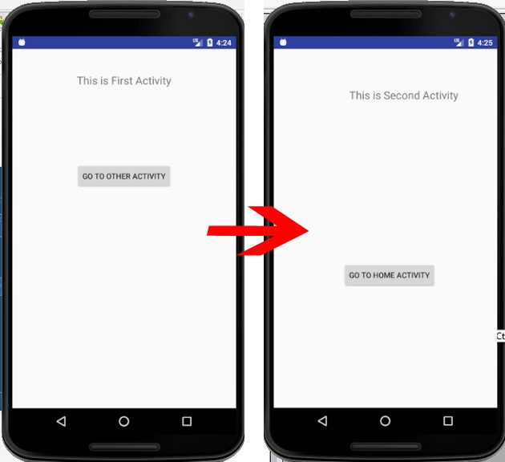
How to Create an Explicit Intent
The most common way is to use the Intent constructor that takes the current context and the class of the component you want to start.
Intent intent = new Intent(CurrentActivity.this, TargetActivity.class);
startActivity(intent);
Example: Starting a New Activity
You have a MainActivity and you want to
open ProfileActivity when a button is clicked.

Slide 33
Android Explicit Intent Example
Button profileButton = findViewById(R.id.profile_button);
profileButton.setOnClickListener(new View.OnClickListener() {
@Override
public void onClick(View v) {
// Create an Explicit Intent
// "this" is the current Context (MainActivity)
// "ProfileActivity.class" is the explicit target
Intent intent = new Intent(MainActivity.this, ProfileActivity.class);
// Start the new Activity
startActivity(intent);
}
});
In ProfileActivity.java, you don't need to do anything special in the onCreate to receive it, as the system knows to launch it directly.
MainActivity.java
[onCreate()]

Slide 34
Passing Data with Explicit Intents
A very common use case is to pass data from one activity to the next.
You do this using Extras.
// Inside MainActivity.java on create( )
Intent intent = new Intent(MainActivity.this, ProfileActivity.class);
  // Put data into the intent
  intent.putExtra("USER_NAME", “John");
  intent.putExtra("USER_AGE", 30);
  intent.putExtra("USER_ID", 12345);
  startActivity(intent);

Slide 35
Passing Data with Explicit Intents
Then, in ProfileActivity.java, you retrieve the data:
// Inside ProfileActivity's onCreate method
Intent intent = getIntent(); // Gets the intent that started this activity
if (intent != null) {
String userName = intent.getStringExtra("USER_NAME");
int userAge = intent.getIntExtra("USER_AGE");
int userId = intent.getIntExtra("USER_ID");
// Now use the data to populate the profile screen
}

Slide 36
Implicit Intents
Imagine you're hungry and you want to eat. You don't care which specific restaurant it is—you just shout, "I want pizza!" Anyone in the room who can provide pizza (a pizzeria, a friend who ordered one, a frozen pizza brand) can respond.
An Implicit Intent is exactly that: you declare a general action you want to perform, and the Android system finds the best component (either from your app or, more commonly, from other apps) that can handle it.
An Implicit Intent does not specify the exact component to start. Instead, it declares a general action to perform, along with optional data. The Android system then searches all installed apps for components that have declared they can handle such an intent and presents the user with a choice (the "Disambiguation Dialog" or "App Chooser").

Slide 37
Implicit intents
Key Characteristics
No Specific Target: You don't specify a class name.
Action-Based: You describe what you want to do (e.g., view a map, send an email, make a phone call).
Inter-App Communication: The primary mechanism for your app to request functionality from other apps.
Resolution Needed: The Android system must find matching components by comparing your intent to the <intent-filter> declarations in other apps' AndroidManifest.xml files.

Slide 38
How to Create an Implicit Intent
You typically use a different constructor that specifies an Action and often a Data URI.
Uri uri = Uri.parse("data_here");
Intent intent = new Intent(Intent.ACTION_NAME, uri);
startActivity(intent);
Intent.ACTION_NAME → The action you want to perform (e.g., ACTION_VIEW, ACTION_DIAL, ACTION_SENDTO, etc.)
Uri.parse("data_here") → The data (like a URL, phone number, location, etc.)
startActivity(intent) → Launches the activity that can handle the intent.

Slide 39
Common Examples of Implicit Intents
1. Opening a Website (ASKING TO VIEW)
// This will open the URL in the user's default browser or give a choice of browsers.
Intent intent = new Intent(Intent.ACTION_VIEW, Uri.parse("https://www.javatpoint.com"));
startActivity(intent);
2. Making a Phone Call (ASKING TO DIAL)
// This opens the dialer with the number pre-filled.
Intent intent = new Intent(Intent.ACTION_DIAL, Uri.parse("tel:0914556915"));
startActivity(intent);

Slide 40
Common Examples of Implicit Intents
3. Viewing a Location on a Map (ASKING TO VIEW A LOCATION)
// This opens a map app (like Google Maps) at the specified coordinates.
Uri uri = Uri.parse("geo:0,0?q=Addis Ababa");
Intent intent = new Intent(Intent.ACTION_VIEW, uri);
startActivity(intent);
4. Sending an Email (ASKING TO SEND)
5. Sharing Content (ASKING TO SEND TEXT/IMAGE)

Slide 41
Common Examples of Implicit Intents
// This opens an email client with the recipient, subject, and body pre-filled.
Intent intent = new Intent(Intent.ACTION_SENDTO);
intent.setData(Uri.parse("mailto:")); // only email apps should handle this
intent.putExtra(Intent.EXTRA_EMAIL, new String[]{"contact@example.com"});
intent.putExtra(Intent.EXTRA_SUBJECT, "Hello from my App!");
intent.putExtra(Intent.EXTRA_TEXT, "This is the email body.");
startActivity(intent);
// This brings up the standard Android share sheet.
Intent intent = new Intent(Intent.ACTION_SEND);
intent.setType("text/plain");
intent.putExtra(Intent.EXTRA_TEXT, "Check out this awesome app!");
startActivity(Intent.createChooser(intent, "Share via")); // "Share via" is the chooser title

Slide 42
Intent filters
An Intent Filter is an XML element declared in an app's AndroidManifest.xml file that specifies the types of intents a component (Activity, Service, or Broadcast Receiver) is willing to accept.
It defines the capabilities of that component.
The intent filter tells android which activities can handle which actions.
<activity android:name=".MyActivity">
<intent-filter>
<!-- Filter details go here -->
</intent-filter>
</activity>

Slide 43
The Three Main Parts of an Intent Filter
1. <action> - What to do
The type of action the component can perform (e.g., view, send, edit).
2. <category> - Who can call it
Additional information about which components can initiate this intent.
3. <data> - What to act upon
The type of data the component can handle (e.g., http URLs, image/* MIME types).

Slide 44
Common Examples
Example 1: Making an Activity the Main Launcher Activity
This is in every app's main activity:
<activity android:name=".MainActivity">
<intent-filter>
<action android:name="android.intent.action.MAIN" />
<category android:name="android.intent.category.LAUNCHER" />
</intent-filter>
</activity>

Slide 45
Common Examples
Example 2: Handling Web Links
Making your app able to open certain websites:
<activity android:name=".WebViewActivity">
<intent-filter>
<action android:name="android.intent.action.VIEW" />
<category android:name="android.intent.category.DEFAULT" />
<category android:name="android.intent.category.BROWSABLE" />
<data android:scheme="https" />
<data android:host="www.myapp.com" />
</intent-filter>
</activity>

Slide 46
What is Service?
A Service is an application component that can perform long-running operations in the background without providing a user interface (UI).
It can run even when the user is not interacting with your app.
Types of Services
1. Foreground Service
2. Background Service
3. Bound Service

Slide 47
1. Foreground Service
A service that the user is actively aware of.
A Foreground Service is a service that stays alive even when the app is terminated.
Foreground Service is a type of service that performs tasks noticeable to the user and must show a notification in the status bar.
Shows a notification that cannot be dismissed unless the service stops
  Used for operations the user is actively aware of (e.g., music playback, file download, GPS navigation)
  Required for long-running operations in Android 8.0 (Oreo) and above
Example: Music Player

Slide 48
1. Foreground Service
// In your Service class
private void startForegroundService() {
// Create notification
Notification notification = new NotificationCompat.Builder(this, "music_channel")
.setContentTitle("Music Player")
.setContentText("Playing your favorite song")
.setSmallIcon(R.drawable.ic_music_note)
.build();
// Start as foreground service
startForeground(1, notification);
// Start playing music...
}

Slide 49
2. Background Service
A Background Service is a service that runs even when the user is not interacting with your app.
A Background Service a service that runs only when the app is running.
It is terminated when the app is terminated.
A service that runs without user awareness.
Drawback
  No notification required
  Heavily restricted in modern Android versions (especially Android 8.0(Oreo)+)
  Consuming too much battery
  Keeping the CPU awake unnecessarily
  Slowing down the device and other apps.

Slide 50
3. Bound Service
A bound service is a service that allows components(clients) – such as activities, fragments, or other apps – to bind to it and interact with it directly.
The communication happens within the same device, inside android’s process system, not over a network.
E.g An activity that lets the user press play/pause buttons. A MusicService that play songs.
Client-server interface: Activity (client) binds to Service (server)
Multiple components can bind to the same service
Service is destroyed when no components are bound to it (unless also started)

Slide 51
Service Lifecycle
The Two Service Lifecycle Paths
Services have two possible lifecycle paths, depending on how they are started:
Started Service (via startService())
Bound Service (via bindService())
A service can be both started AND bound, in which case it must handle both lifecycles.
1. Started Service Lifecycle
This is used when a service needs to perform a single operation and doesn't return results to the caller.
Lifecycle Methods for Started Service:
onCreate() → onStartCommand() → running → onDestroy()

Slide 52
Method Details
onCreate()
Called when: The service is first created
Purpose: One-time setup (initialize variables, prepare resources)
Note: Called only once, even if startService() is called multiple times
onStartCommand(Intent intent, int flags, int startId)
Called when: Another component calls startService()
Parameters:
intent: The Intent passed to startService()
flags: Additional data about the start request
startId: A unique ID representing this specific start request

Slide 53
Method Details
Return value: Must return one of these constants:
START_NOT_STICKY: Service won't be recreated if killed
START_STICKY: Service will be recreated with null intent
START_REDELIVER_INTENT: Service will be recreated with original intent on
Destroy()
Called when: The service is no longer used and is being destroyed
Purpose: Clean up resources (threads, receivers, etc.)

Slide 54
Started Service: Example
public class MyStartedService extends Service {
private static final String TAG = "MyStartedService";
public void onCreate() {
super.onCreate();
Log.d(TAG, "onCreate called");
// Initialize resources here
}
public int onStartCommand(Intent intent, int flags, int startId) {
Log.d(TAG, "onStartCommand called with startId: " + startId);
// Perform your long-running task here
performBackgroundTask();
// Return how system should behave if service is killed
return START_NOT_STICKY;
}

Slide 55
Started Service: Example
public void onDestroy() {
super.onDestroy();
Log.d(TAG, "onDestroy called");
// Clean up resources here
}
public IBinder onBind(Intent intent) {
// Return null because this is a started service
return null;
}
private void performBackgroundTask() {
// Simulate background work
new Thread(() -> {
// Do some work

Slide 56
Started Service: Example
try {
Thread.sleep(5000);
Log.d(TAG, "Background task completed");
} catch (InterruptedException e) {
e.printStackTrace();
}
}).start();
}
}
// Starting the service from an Activity
Intent serviceIntent = new Intent(this, MyStartedService.class);
serviceIntent.putExtra("DATA_KEY", "some_data");
startService(serviceIntent);
// Stopping the service:
stopService(new Intent(this, MyStartedService.class));

Slide 57
2. Bound Service Lifecycle
This is used when components need to interact with the service through a client-server interface.
Lifecycle Methods for Bound Service:
onCreate() → onBind() → clients connected → onUnbind() → onDestroy()
Method Details:
onCreate()
Same as in started service - for one-time initialization
onBind(Intent intent)
Called when: First client binds to the service
Purpose: Return an IBinder that clients use to interact with the service
Return: Must return a non-null IBinder implementation

Slide 58
2. Bound Service Lifecycle
onUnbind(Intent intent)
Called when: All clients have disconnected
Return: true if you want onRebind() to be called later
onRebind(Intent intent)
Called when: New clients connect after onUnbind() returned true
onDestroy()
Clean up resources

Slide 59
Commonly Used Built-in Services
Connectivity Manager - Network status
Location Manager - GPS services
Notification Manager - Notifications
Audio Manager - Sound control
Sensor Manager - Device sensors
Alarm Manager - Task scheduling
Telephony Manager - Phone information
Vibrator - Haptic feedback
Power Manager - Battery optimization
Input Method Manager - Keyboard control

Slide 60
Characteristics of Mobile Applications
Startup time
  Quick startup
Responsiveness
  Acknowledgement for every activity
Focused purpose
  Having clearly defined set of things
Consistency of experience
  Provides consistent user experience

Slide 61
Steps for Successful Mobile App Development
App idea ( problem and features of the app )
Identification/clarification( users, platform, revenue )
Identify development approach ( native, hybrid, web )
Make app prototype
Integrate analytics tool ( Google analytics )
Identify your testers
Release / deploy the app
Capture the metrics ( usage pattern from analytics )
Upgrade your app (improvements and suggestions )

Slide 62
≈ ∕∕ ≈

